Slide 1


DATA VISUALIZATION IN PYTHON
USING MATPLOTLIB
WITH PYPLOT:-

Slide 2

TOPICS:-
INTRODUCTION TO DATA VISUALIZATION.
SOME POPULAR PLOTTING LIB. IN PYTHON.
INTRODICTION TO MATPLOTLIB
LINE PLOT/CHART
BAR GRAPH/CHART
HISTOGRAM
SCATTER PLOT
FREQUENCY POLYGON
PIE CHART
BOX PLOT

Slide 3

INTRODUCTION TO DATA VISUALIZATION :-
Data visualization is the discipline of trying to understand data by placing it in a visual context so that patterns, trends and correlations that might not otherwise be detected can be exposed.Python offers multiple great graphing libraries that come packed with lots of different features. No matter if you want to create interactive, live or highly customized plots python has an excellent library for you.

Slide 4
SOME POPULAR PLOTTING LIBRARIES IN PYTHON:-
MATPLOTLIB》low level, provides lots of freedom...
Pandas Visualization》 easy to use interface, built on Matplotlib
Seaborn》 high-level interface, great default styles
Ggplot》based on R’s ggplot2, uses Grammar of Graphics
Plotly》can create interactive plots

Slide 5

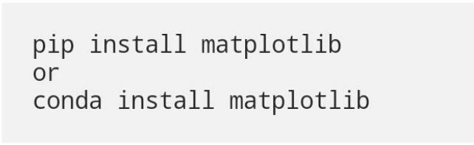
MATPLOTLIB:-
Matplotlib is the most popular python plotting library. It is a low-level library with a Matlab like interface which offers lots of freedom at the cost of having to write more code.
To install Matplotlib pip and conda can be used.

Slide 6


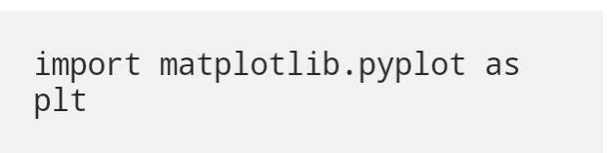
Matplotlib is specifically good for creating basic graphs like line charts, bar charts, histograms and many more. It can be imported by typing:

Slide 7
PYPLOT:-
pyplot is a module in matplotlib, which supports a very wide variety of graphs and plots
namely - histogram, bar charts, power spectra, error charts etc. It is
used along with NumPy to provide an environment for MatLab.
Pyplot provides the state-machine interface to the plotting library in
matplotlib.It means that figures and axes are implicitly and
automatically created to achieve the desired plot. For example,
calling plot from pyplot will automatically create the necessary
figure and axes to achieve the desired plot. Setting a title will then
automatically set that title to the current axes object.The pyplot
interface is generally preferred for non-interactive plotting (i.e.scripting)

Slide 8
LINE CHART/PLOT:-
A line chart or line plot or line graph or curve chart^{[1]} is a type of chart which displays information as a series of data points called 'markers' connected by straight line segments.^{[2]} It is a basic type of chart common in many fields. It is similar to a scatter plot except that the measurement points are ordered (typically by their x-axis value) and joined with straight line segments. A line chart is often used to visualize a trend in data over intervals of time – a time series – thus the line is often drawn chronologically. In these cases they are known as run charts

Slide 9
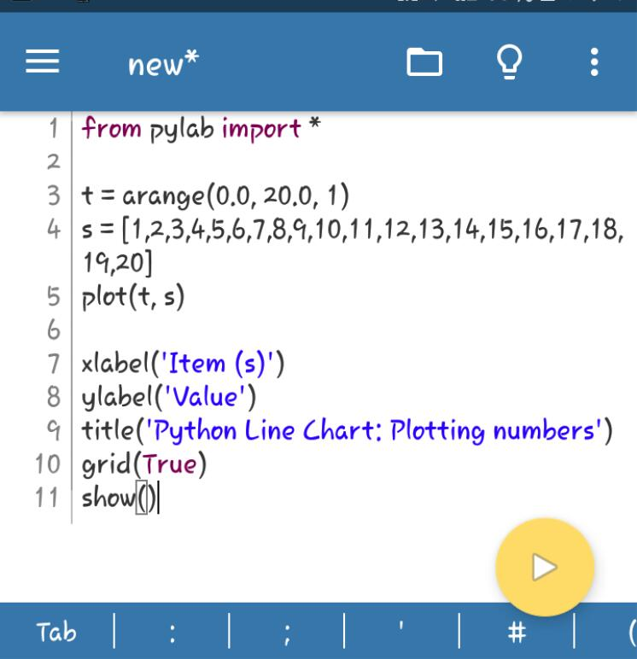
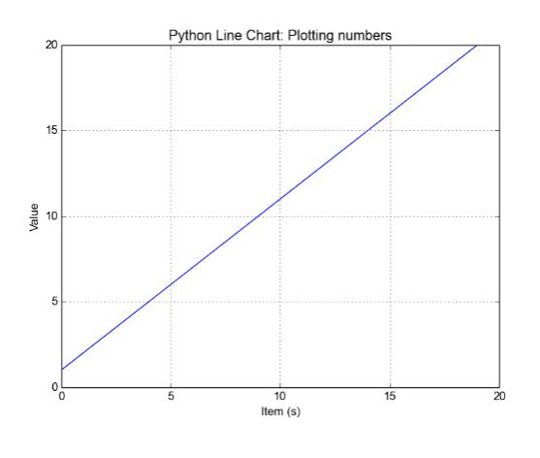
EXECUTION AND OUTPUT:-

Slide 10
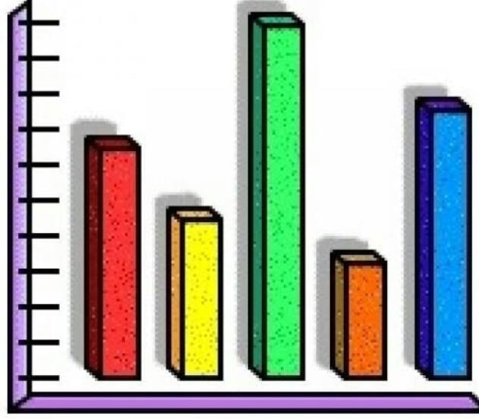
BAR GRAPH:-
A bar chart represents categorical data with rectangular bars. Each bar has a height corresponds to the value it represents. It is useful when we want to compare a given num value on different categories, It can also be used with two data series. The bars can be ple vertically or horizontally.A bar chart/bar graph is a very commonly used two-dimensional data visualization made of rectangular bars, each for a specific category, with its length representing the value of the category Additionally, we can also configure other characteristics for the chart, like width of the bar colour, etc, among others. The X-axis will be a range with the same quantity of items as th Y-axis. Let us take a simple example where we will store the configurations we want in variable and then will pass them to the bar() function:To make a bar chartwith matplotlib, we need to use the pit bar function.

Slide 11
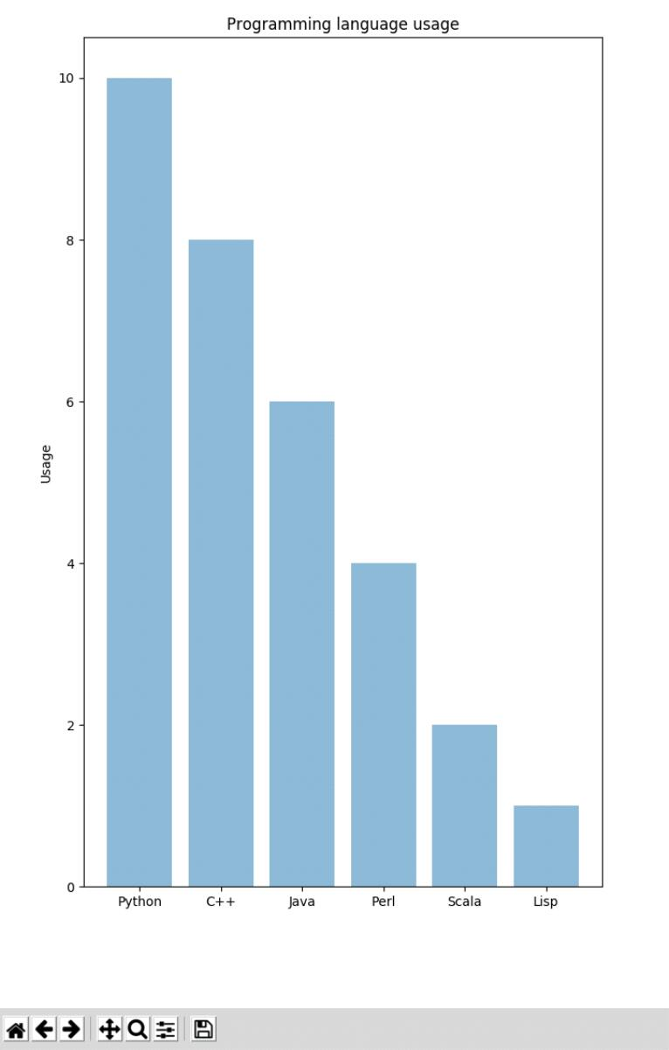
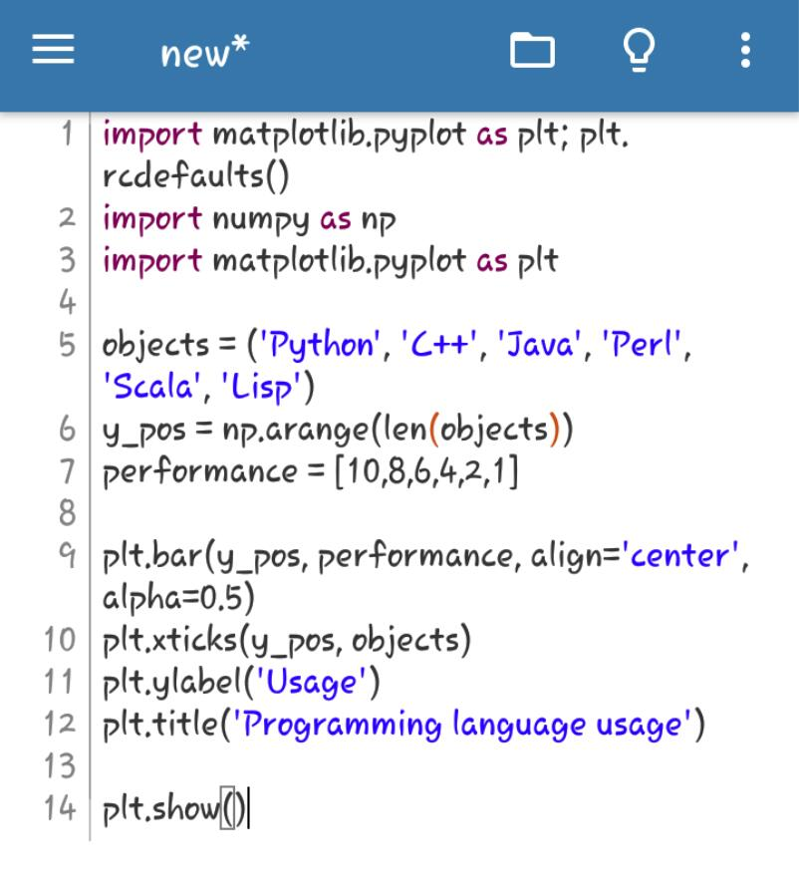
EXECUTION AND OUTPUT:-

Slide 12

HISTOGRAM:-
In Matplotlib we can create a Histogram using the hist method. If we pass it categorical data like the points column from the wine-review dataset it will automatically calculate how often each class occurs.

Slide 13
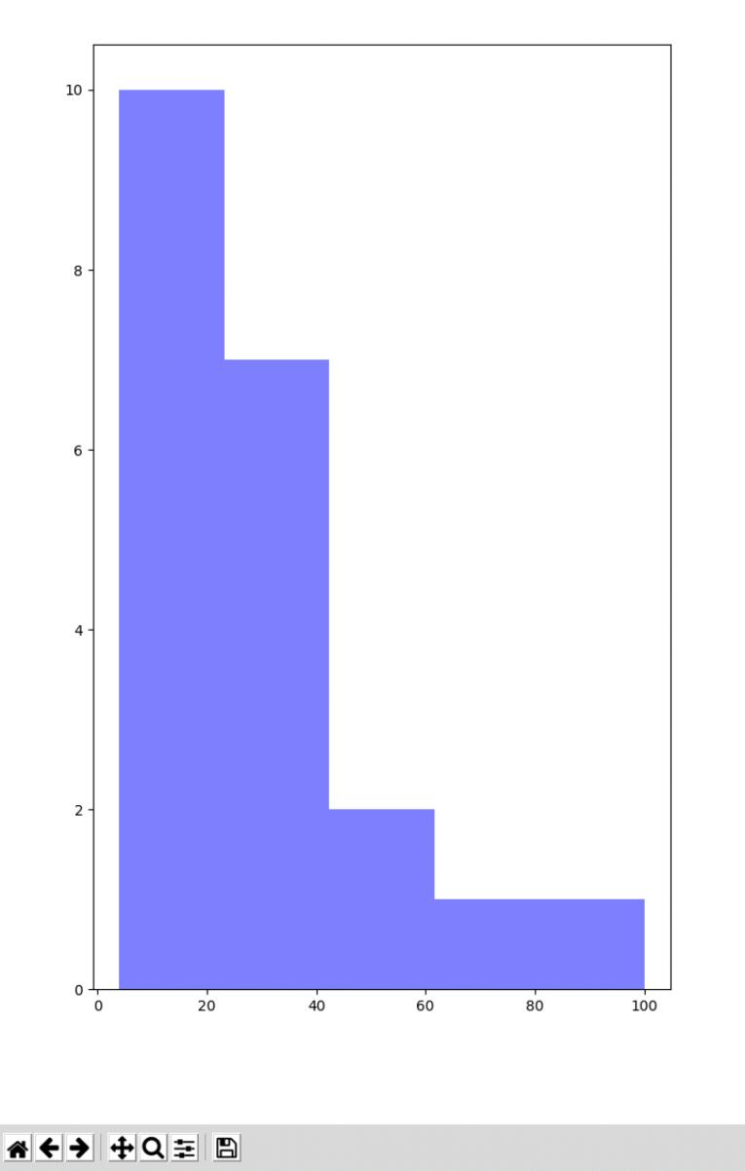
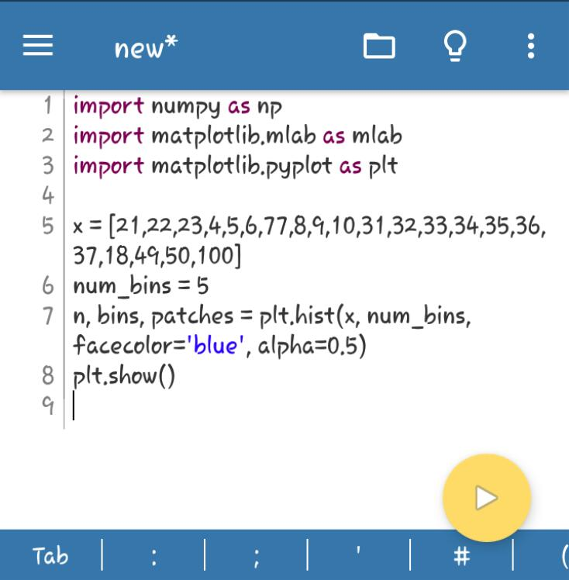
EXECUTION AND OUTPUT:-

Slide 14
SCATTER PLOT:-
A scatter plot (also called a scatterplot, scatter graph, scatter chart, scattergram, or scatter diagram)^{[3]} is a type of plot or mathematical diagram using Cartesian coordinates to display values for typically two variables for a set of data. If the points are coded (color/shape/size), one additional variable can be displayed. The data are displayed as a collection of points, each having the value of one variable determining the position on the horizontal axis and the value of the other variable determining the position on the vertical axis.^{[4]}

Slide 15
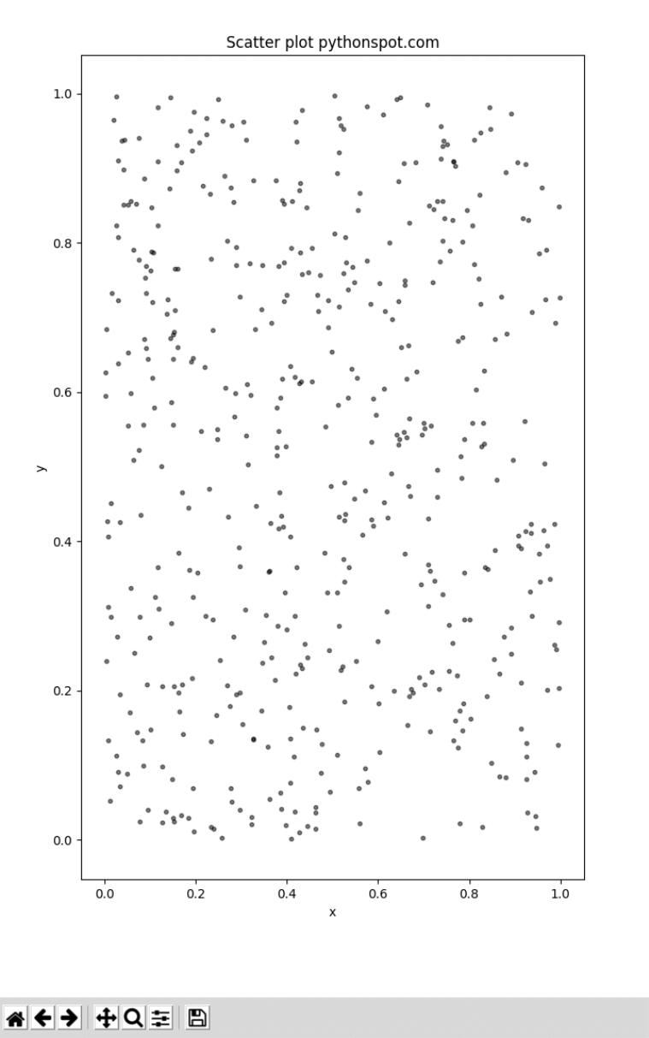
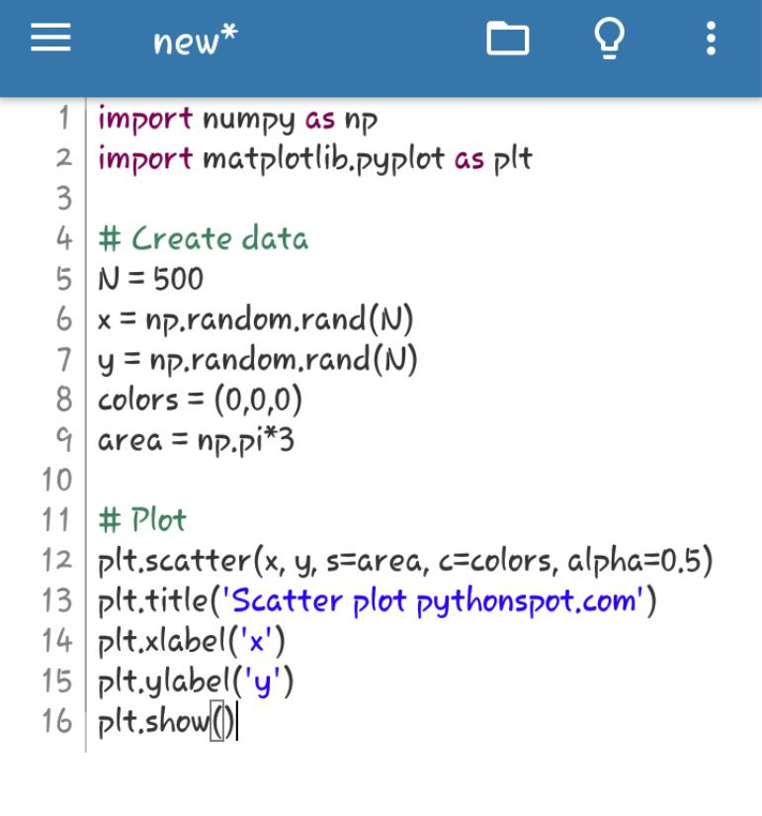
EXECUTION AND OUTPUT:-

Slide 16
FREQUENCY POLYGON:-
Frequency polygons are a graphical device for understanding the shapes of distributions. They serve the same purpose as histograms, but are especially helpful for comparing sets of data. Frequency polygons are also a good choice for displaying cumulative frequency distributions.In a frequency polygon, the number of observations is marked with a single point at the midpoint of an intervalA straight line then connects each set of points. Frequency polygons make it easy to compare two or more distributions on the same set of axes..

Slide 17
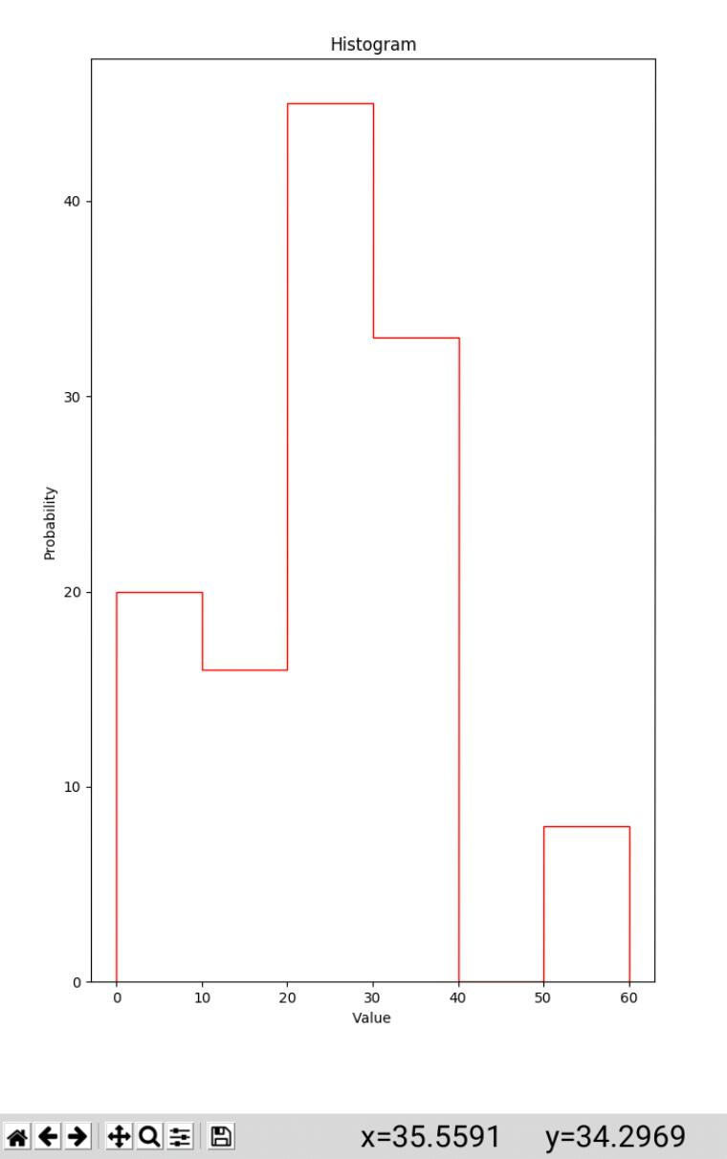
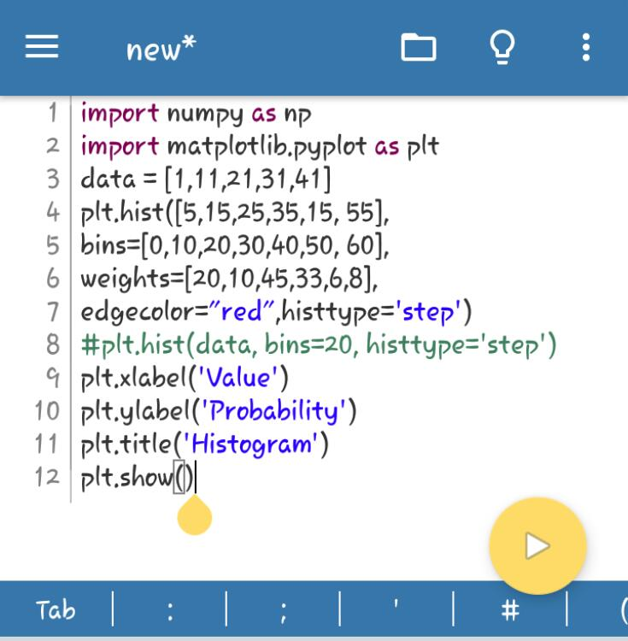
EXECUTION AND OUTPUT:-

Slide 18
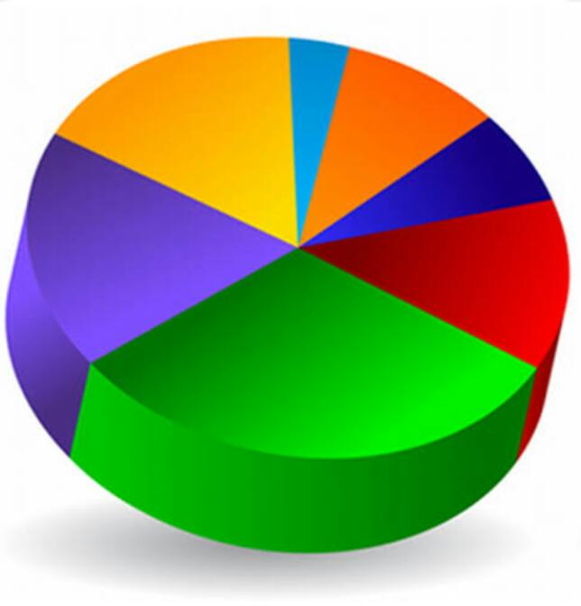
PIE CHART:-
Pie charts can be drawn using the function pie() in the pyplot module. The below python code example draws a pie chart using the pie() function. By default the pie() fucntion of pyplot arranges the pies or wedges in a pie chart in counter clockwise direction.

Slide 19
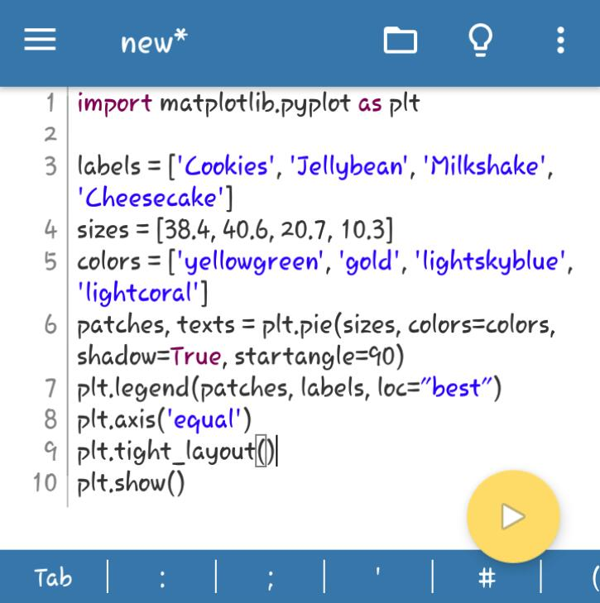
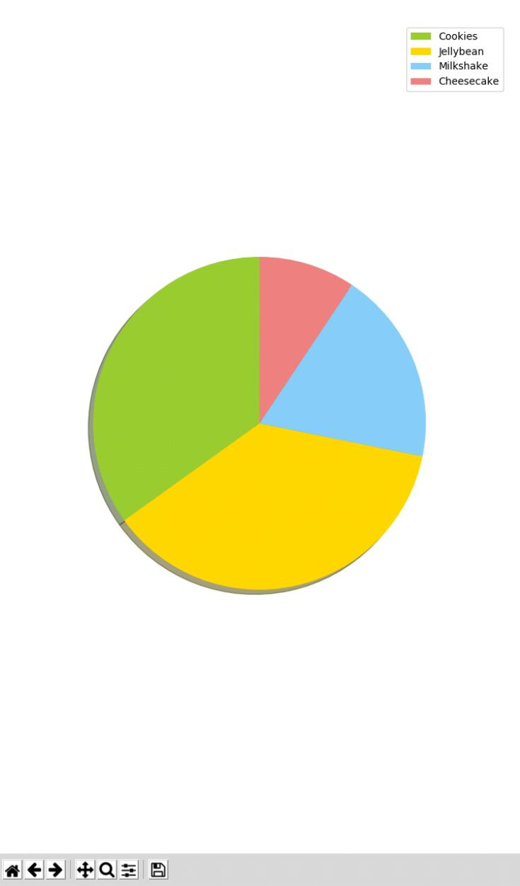
EXECUTION AND OUTPUT:-

Slide 20
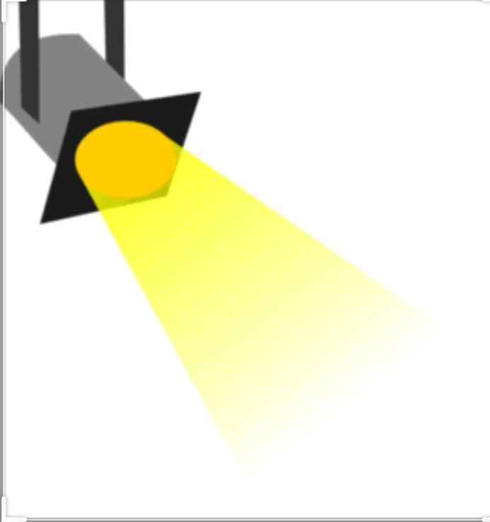
BOXPLOT:-
A Box Plot is also known as Whisker plot is created to display the summary of the set of data values having properties like minimum, first quartile, median, third quartile and maximum. In the box plot, a box is created from the first quartile to the third quartile, a verticle line is also there which goes through the box at the median. Here x-axis denotes the data to be plotted while the y-axis shows the frequency distribution.

Slide 21
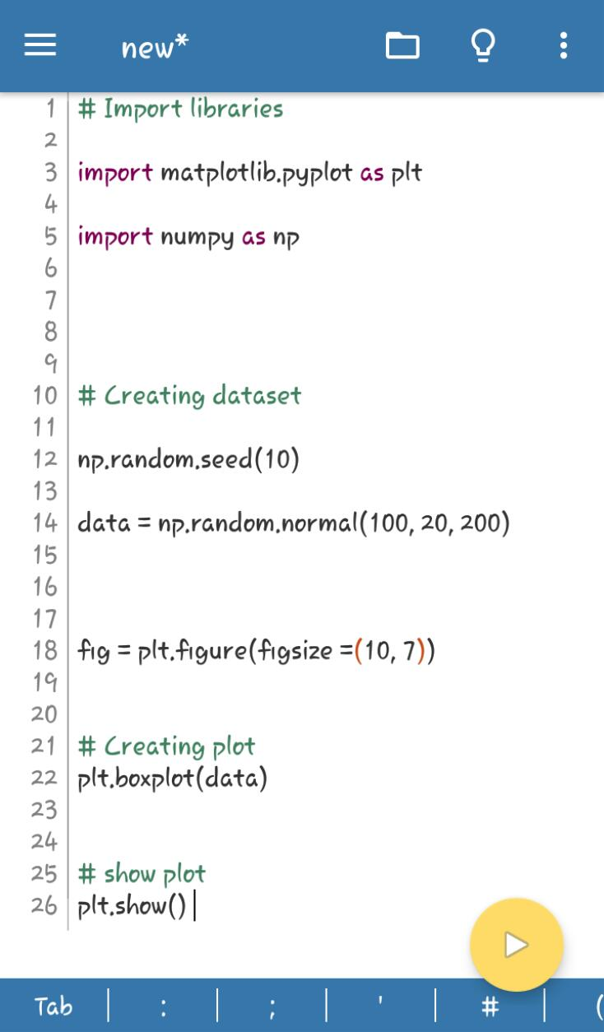
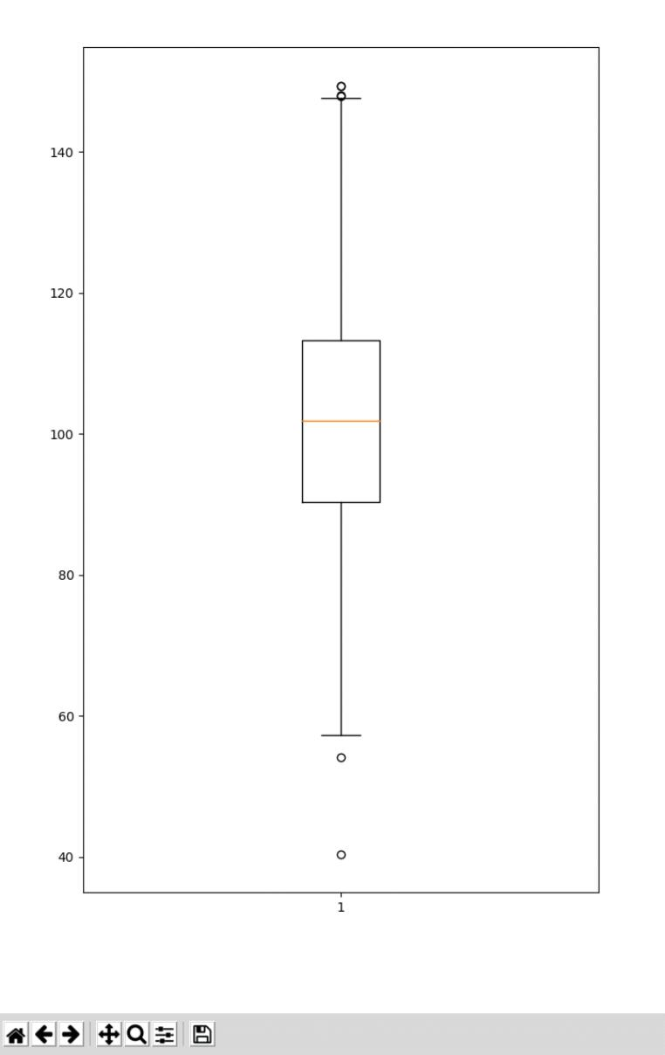
EXECUTION AND OUTPUT:-

Slide 22

BY – KHUSHI GUPTA

